Slide 1
Cognitive Modeling Lecture 2 Time Estimation

Slide 2
Interval timing is the capacity to estimate the duration of (short) intervals

Slide 3
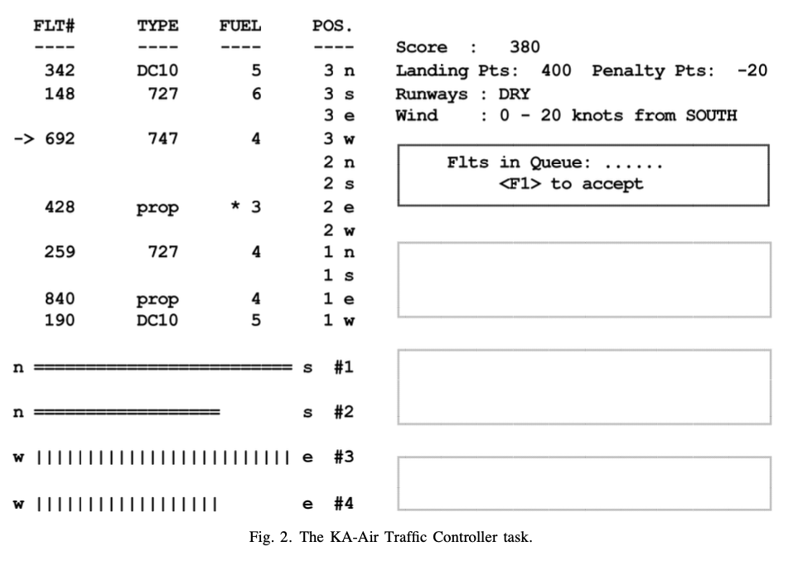

Slide 4
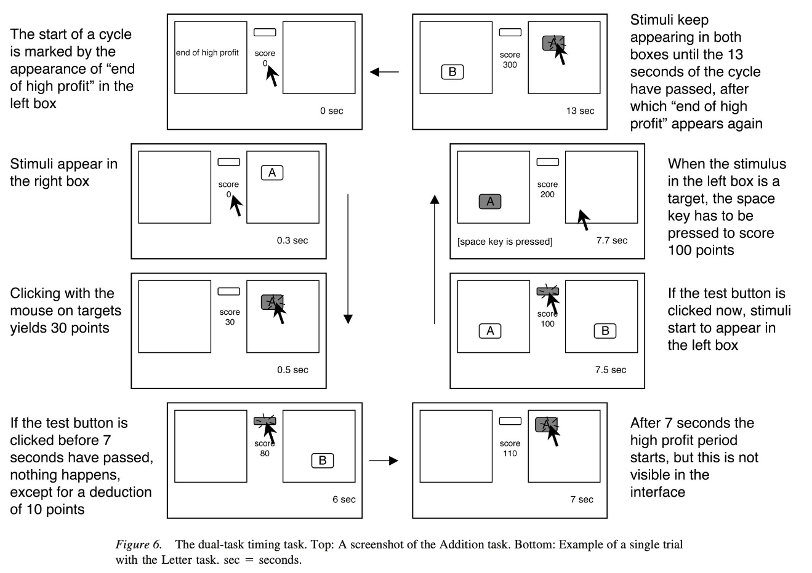

Slide 5
Why bother with time?
Timing is automatic, and implicit.
Timing is implicit in many tasks / settings
Language:
Using pauses as a rhetorical tool.
Turn-taking in conversation.
Human-Environment Interaction:
Adapting to the pace of the environment
Psychological Experiments

Slide 6
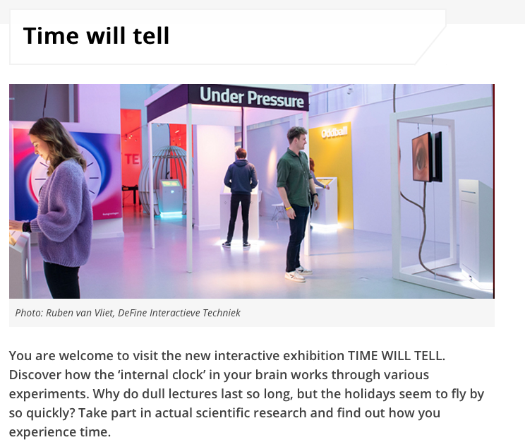

Slide 7
Temporal Decision making

Slide 8



Slide 12
Red or Green
longer?

Slide 13
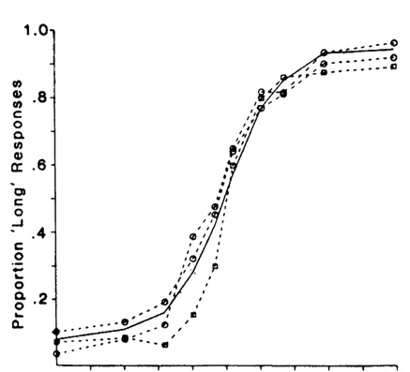
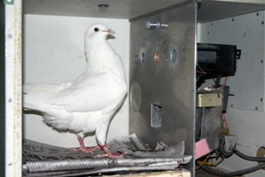
P(“Red longer”)
http://www.uky.edu/~zentall/recentpublication.html
Green longer
Equal
Red longer
Adapted from Heinemann (1984) Annals NY Academy of Sciences

Slide 14
Ready-Set-Go

Slide 15
Notes:
Temporal generalization

Slide 22
Reproduction

Slide 28
Correct!
Too fast!
Too slow!

Slide 29
Results: Scalar Property

Slide 30
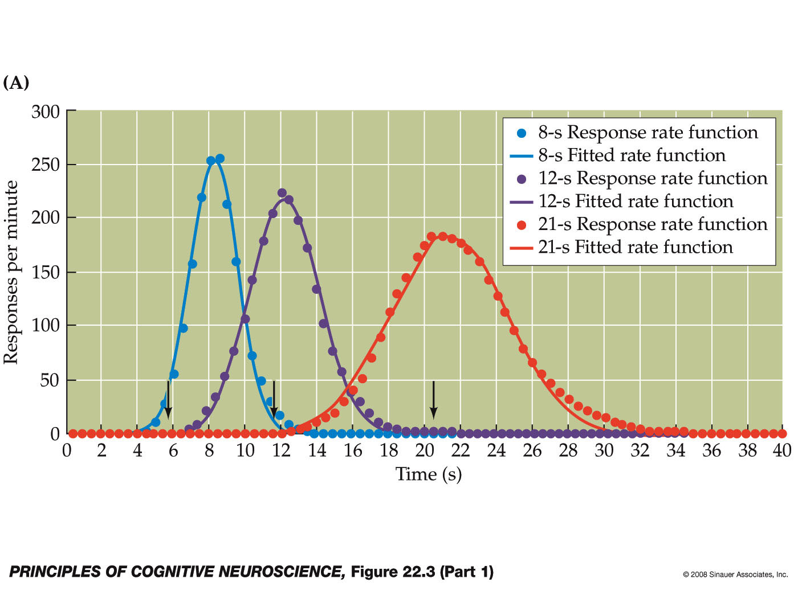
Peak Procedure

Slide 31
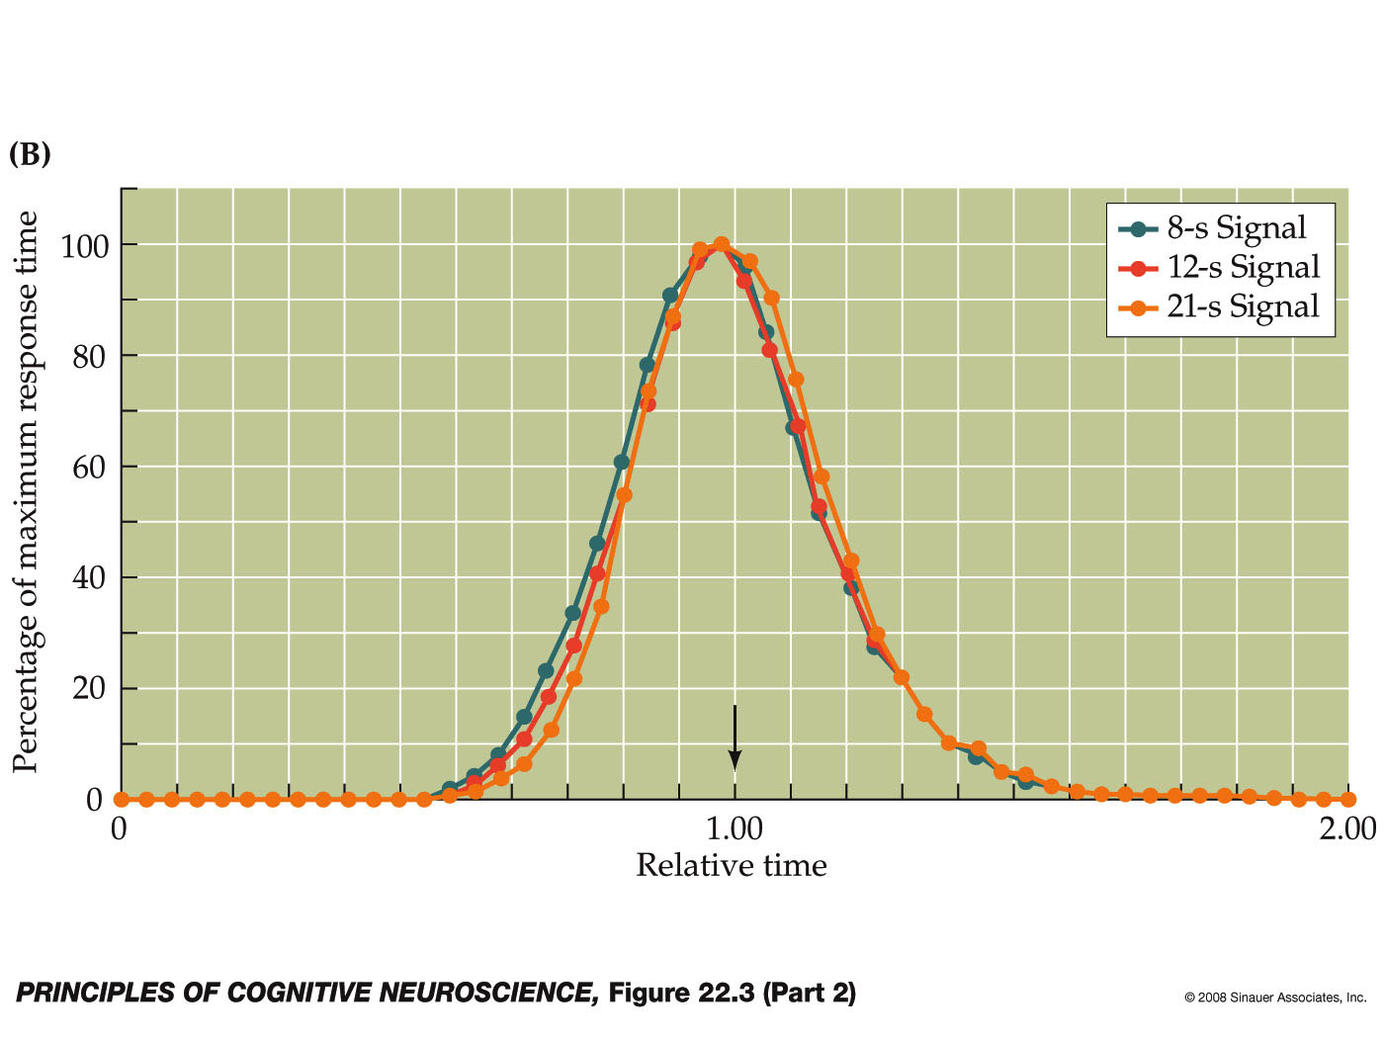
Scalar Property

Slide 32
What drives interval timing?

Slide 33
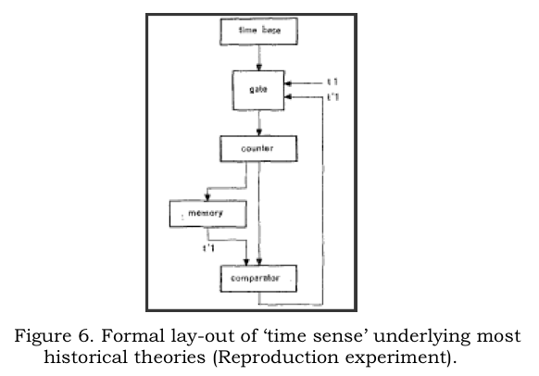
Information Processing Approaches to Interval Timing
(e.g., Creelman, 1962, Michon, 1967, Gibbon, 1977, Treisman, 1963)
Notes:
Temporal behavioral requires more than “just time”, it has to be embedded in a broader cognitive system.
“Modified church and gibbon model”

Slide 34
IP Models of Interval Timing
(e.g., Creelman, 1962, Michon, 1967, Gibbon, 1977, Treisman, 1963, etc)

Slide 35
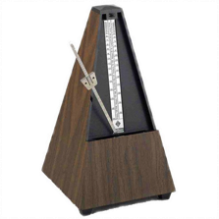
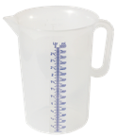

Scalar Timing Theory

Slide 36

Scalar Timing Theory
2
4
1
3
Notes:
Red or green (left or right) longer on the screen?

Slide 37
Scalar Timing Theory
2
1
3
4
Notes:
It could be, of course, that instead of a perfect match, an “close match” would have been sufficient to trigger the “same” response.

Slide 38
Scalar Timing Theory
3
4
Green or Red?
Red
Notes:
It could be, of course, that instead of a perfect match, an “close match” would have been sufficient to trigger the “same” response. But what determines whether a match is “close”? Well, these types of models don’t provide us with an answer…

Slide 39
IP Models of Interval Timing
Notes:
It could be, of course, that instead of a perfect match, an “close match” would have been sufficient to trigger the “same” response. But what determines whether a match is “close”? Well, these types of models don’t provide us with an answer…

Slide 40
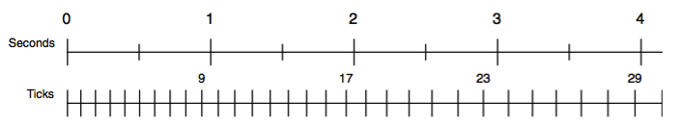
Timing Module
Idea: Metronome that starts ticking fast, but gradually slows down
The current value of the accumulator is available to the rest of cognition
At any moment, the accumulator can be read or matched in the condition of a production

Slide 41
Stochastic Process
t₀ = length of starting pulse
t_{n+1}= a x t_{n} + noise(M=0, SD=b x a x t_{n})
Noise = logistic noise (ACT-R default, normal-like)
Two sets of parameters:
t₀ = 11 ms, a = 1.1, b = 0.015 t₀ = 100 ms, a = 1.02, b = 0.015

Slide 42
PRIMs implementation
T buffer with three slots:
T1 has the current pulse count
T2 is set to T whenever the pulse count is incremented (allowing the model to respond, and set it back to nil)
T3 is used to control the timer:
Put “start” in it to start the timer
Put “stop” in it to stop the timer

Slide 44
Peak time model
operator register-start {
V1 = start
T1 = nil
==>
start -> T3
wait -> AC1
}
operator register-stop {
V1 = stop
WM1 = nil
==>
interval -> WM1
T1 -> WM2
nil -> WM0 // push it into declarative memory
stop -> T3
wait -> AC1
}

Slide 45
Reproduce
operator start-reproduce {
V1 = reproduce
T1 = nil
==>
start -> T3
}
operator retrieve-time {
V1 = reproduce
RT1 = nil
==>
interval -> RT1
}

Slide 46
Reproduce
operator time-is-reached {
V1 = reproduce
T1 = RT2
==>
press -> AC1
stop -> T3
}
operator time-is-not-reached {
V1 = reproduce
T1 <> RT2
==>
focus -> AC1
}

Slide 47
Two other interesting aspects of the model
It uses “blending” for its retrieval, so it mixes past experiences
The to be estimated interval can be set in the batch script

Slide 48
Setting parameters in the batch script
In the batch script
repeat 10
reset
run peak-time peak-time8 300 8.0
reset
run peak-time peak-time12 300 12.0
reset
run peak-time peak-time21 300 21.0
In the model script
parameters = batch-parameters()
if (parameters != "NA") {
runtime = parameters[0]
}

Slide 49
Demo: Peak procedure

